Slide 1
PCL processing algorithm

Slide 2
Index
1. Point cloud pre-processing
1.1 Downsampling
1.2 Outlier Removal
1.3 Segmentation
2. Point cloud clustering
3. Registration
4. Recognition algorithms
4.1 Similarity score

Slide 3
1.1 DownSampling
To act on a cloud, the total number of points is a key variable which, if reduced, can greatly speed up other applied treatments. Used specifically in big dimension clouds.
Methods:
Random DownSampling: Using a UniformSampling(); filter is possible to eliminate random points of the cloud and simplify it.
Simplicity in implementation: Only the number of points to be deleted is required
Only preserves the cloud shape if the number of samples is big enough
May lead to a loss of information if single points are distributed in space

Slide 4
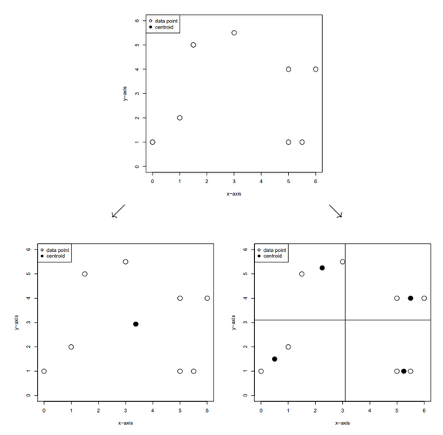
1.1 DownSampling
Voxel Grid Filtering: Divide the point cloud into cubes and replace the points it contains with its centroid using the PCL function.
Nearly uniform density along the distance from the sensor.
Preserves the cloud shape and doesn’t produce a loss of information.
Requires iterations in order to obtain the correct voxel size to reduce the desired number of points of the cloud.

Slide 5
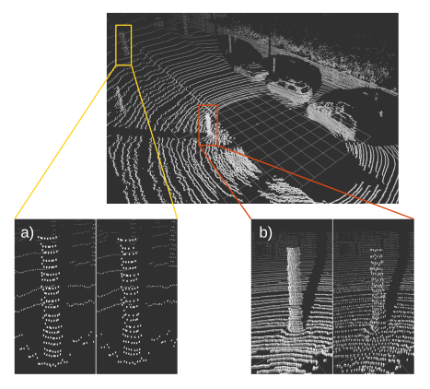
1.1 DownSampling
Example of the effect of DownSampling using Voxel Grid Filter

Slide 6
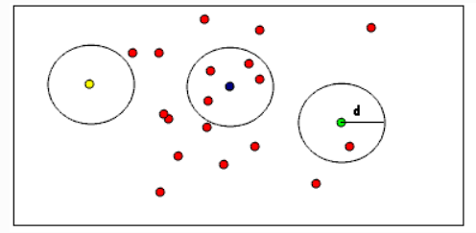
1.2 Outlier removal
After simplifying the point cloud with DownSampling, irrelevant information must be removed. This is achieved by eliminating planes and areas that do not provide relevant information.
Methods:
RadiusOutlierRemoval Background: It consists of the elimination of points that do not have other points within a certain distance.
Simple and effective method
Limitation in the quality of the outlier removal depending of the k-points selected

Slide 7
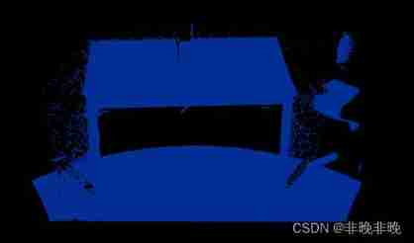
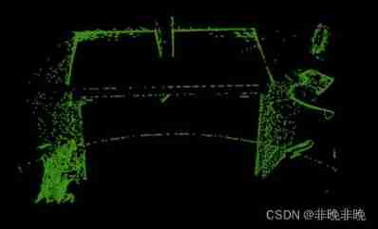
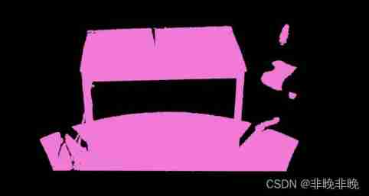
1.2 Outlier removal
StatisticalOutlierRemoval filter: Doing a statistical analysis to each point in order to compute the mean distance from all its neighbours. Then assuming the distribution is Gaussian an interval is defined, so the points with a mean outside it are deleted.
Simple and effective method
Limitation in the quality of the outlier removal depending of the values of the Gaussian parameters selected
Notes:
Some of these irregularities can be solved by performing a statistical analysis on each point’s neighborhood, and trimming those which do not meet a certain criterion. Our sparse outlier removal is based on the computation of the distribution of point to neighbours distances in the input dataset. For each point, we compute the mean distance from it to all its neighbors. By assuming that the resulted distribution is Gaussian with a mean and a standard deviation, all points whose mean distances are outside an interval defined by the global distances mean and standard deviation can be considered as outliers and trimmed from the dataset.

Slide 8
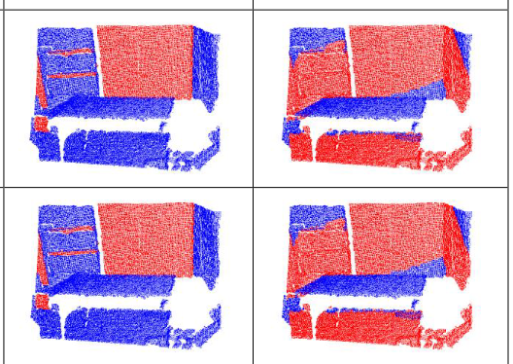
1.3 Segmentation (extra simplification)
It consists in the segmentation of the point cloud into different content planes in order to discard unimportant information..
Methods:
RANSAC: finds the largest set of points that fit to plane. RANSAC selects randomly three points from dataset and calculates the parameters of the corresponding plane, after that tries to enlarge the plane according to a given threshold.
Allows an extra simplification of the elements
Require an extra parametrization depending of the cloud

Slide 9
1.4 Keypoints estimation
By this operation some points that are supposed to be important are selected. There are three main methodologies available in the PCL.
1. NARF (Normal Aligned Radial Feature) keypoint extraction (university Freiburg document 1):
Notes:
The method makes explicit use of object boundary information and tries to extract the features in areas where the surface is stable but has substantial change in the vicinity. (Abstract Freiburg)
i) it must take information about borders and the surface structure into account;
ii) it must select positions that can be reliably detected even if the object is observed from another perspective (this option is more for the composition of the 3d cloud from the 2d one)
iii) the points must be on positions that provide stable areas for normal estimation or the descriptor calculation in general.

Slide 10
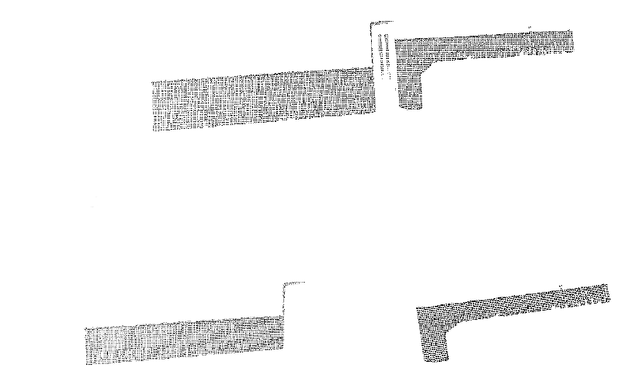
2. Point cloud clustering
The main objective of clustering is to differentiate the different objects or surfaces that make up the filtered pcl cloud. This way the processing time is considerably reduced.
Methods:
Euclidean Cluster Extraction:
Notes:
Page 30 Master Damm document

Slide 11
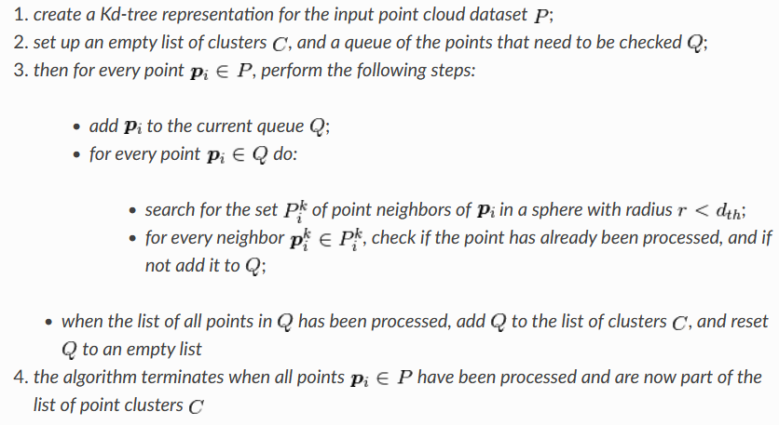
2. Point cloud clustering
Algorithm used in Euclidean clustering:

Slide 12
3. Registration
The point-cloud registration or scan matching, is the process of finding a spatial transformation (e.g., scaling, rotation and translation) that aligns two or more point clouds. For doing that the different algorithms find the correspondences between the different clouds.
Notes:
API: Its goal is to find the relative positions and orientations of the separately acquired views in a global coordinate framework, such that the intersecting areas between them overlap perfectly
Motivated by finding correct point correspondences in the given input datasets, and estimating rigid transformations that can rotate and translate each individual dataset into a consistent global coordinate framework.

Slide 13
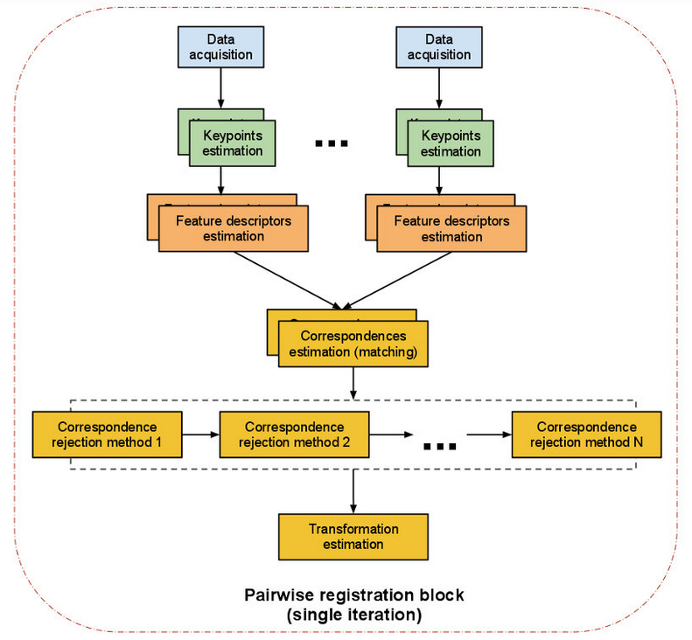
Pairwise registration
The pairwise registration is the transformation to register a couple of clouds, and its output is a transformation matrix (4x4). This transformation matrix represents the Rot+trans that is needed to align the source and the target cloud.
Notes:
The registration needs the estimation of keypoints due to the huge number of points that a normal point cloud usually contains (300k). Is also possible to process the whole clouds TIME CONSUMING.

Slide 14
4.1 Similarity score
This method consist at comparing both clouds, the input one (B) and the source/s (A) and deciding if they are close enough.
This comparison could be done by obtaining the distance of each point of the cloud B to A points and make a decision using this algorithm. There exist plenty ways of calculating this distance that will require evaluation with validation clouds.
Method with high percentage reliability for closed geometric shapes with standardized components
Relatively easy to implement
Can afford real-time performance
It is strongly affected by noise (solvable by doing a complete pre-processing of the PC)

Slide 16
Raspberry pi 3 b+
Continue with literature research (prepro, recognition algorithms)
Add to the presentation a table of all algorithms with qualitative classification
Extract static pc from Ros/Gazebo. Also think how to prepro the 2D dynamic cloud
Create a timetable for organization

Slide 17
Hunjung, L. (n.d.). Downsampling a PointCloud using a VoxelGrid filter-PCL-CPP. Downsampling a PointCloud using a VoxelGrid filter-PCL-Cpp · PCL. Retrieved May 9, 2022, from https://adioshun.gitbooks.io/pcl/content/Tutorial/Filtering/pcl-cpp-downsampling-a-pointcloud-using-a-voxelgrid-filter.html
Damm, C. (2016). Object detection in 3D point clouds. Retrieved May 9, 2022, from https://www.mi.fu-berlin.de/inf/groups/ag-ki/Theses/Completed-theses/Master_Diploma-theses/2016/Damm/Master-Damm.pdf
[PCL of point cloud processing technology] filter -- outlier filter. [PCL of Point Cloud Processing Technology] filter -- outlier filter (statistical outlier removal, conditional removal and radius outlier removal). (n.d.). Retrieved May 9, 2022, from https://chowdera.com/2022/02/202202041614419220.html
Peter. (2021, January 8). Point Cloud Library introduction. Agmanic Vision. Retrieved May 9, 2022, from https://agmanic.com/point-cloud-library-introduction/

Slide 18
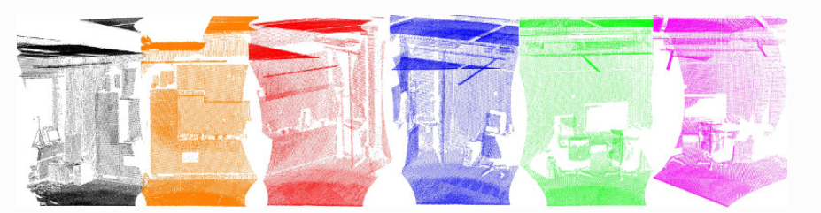
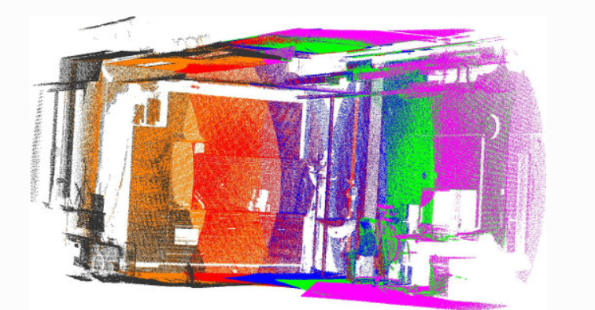
Appendix
The API algorithm used for the point cloud registration could also be used for the 3D cloud composition from the static 2D clouds that the Lidar obtain.
This images are obtained from a Lidar 2D tilting unit

